Slide 1
Prepared By: Muhammad Aseef Jawad Zunain Ahmed

Slide 2
Movies List:
Green Book.
Venom, The Last Dance.
Titanic.
The Dark Night.
Jurassic World.
Inception.
Avatar.
Avengers.
Matrix.
Parasite.

Slide 3
MOVIES NAME
Genre:
IMDB Rating:
Green Book.
Venom, The Last Dance.
Titanic.
The Dark Night.
Jurassic World.
Inception.
Avatar.
Avengers.
Matrix.
Parasite.
Biography, drama, comedy.
Action, science fiction, thriller.
Romance, drama.
Action, crime, drama.
Science fiction, adventure, action.
Science fiction, thriller.
Adventure, fantasy.
Action, adventure, science fiction.
Science fiction, action.
Thriller, drama.
8.2
5.9
7.9
9
6.9
8.8
7.8
8.4
8.7
8.5

Slide 4
Summary Of Green Book:
"Green Book" is a movie about an unlikely friendship between Tony Lip, a working-class Italian-American bouncer, and Dr. Don Shirley, a sophisticated African-American pianist. Set in the 1960s during a music tour in the racially segregated Southern United States, Tony becomes Dr. Shirley’s driver and bodyguard. Throughout the journey, they face racism and prejudice, but also share moments of humour and connection. The trip changes both of them, breaking down barriers and forming a deep bond despite their differences. The film is based on a true story.

Slide 5
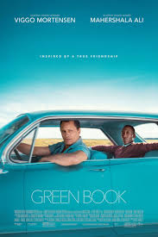
Personal Review:
"Green Book" is a heartwarming and enjoyable movie with strong performances by the lead actors. It tackles serious issues like racism in a way that's both emotional and up lifting. The chemistry between the characters makes it fun to watch, blending humour with meaningful moments. While the story may seem simplified for Hollywood, it's a feel-good film that leaves you with a positive message about friendship and understanding.

Slide 6
Summary Of Venom, The Last Dance:
"Venom: The Last Dance" follows Eddie Brock and his symbiotic partner, Venom, as they face new threats while on the run. The story involves the pair encountering a powerful new adversary, the Xenophage, sent by Knull, the creator of symbiotes. The movie blends action and dark humour, shifting away from previous films' horror elements. It culminates in a dramatic showdown at Area 51, with Venom making a significant sacrifice to save Eddie and stop the alien threat. The film also features a mix of emotional moments and comedic scenes, marking a shift in tone compared to earlier installments.

Slide 7

Personal Review:
"Venom: The Last Dance" feels like a mixed bag. It leans heavily into comedy, which might be fun for some, but it lacks the intensity and darker tone that fans of the original movies enjoyed. The dynamic between Eddie and Venom becomes more like a bickering couple, which takes away from the action. Some of the plot elements feel random and out of place, leading to a disjointed experience. While there are some funny moments and a strong performance by Tom Hardy, the film struggles to balance its humour with the expected superhero action. Overall, it’s an average watch, best suited for those who enjoy a lighter take on the Venom character.

Slide 8
Summary Of Titanic:
"Titanic" is a romantic drama set aboard the famous RMS Titanic, a luxury ship that sank on its maiden voyage in 1912. The film follows the love story of Jack, a poor artist, and Rose, a wealthy young woman trapped in a controlling relationship. They meet and fall in love despite their different social backgrounds. However, their romance is cut short when the Titanic hits an iceberg and starts sinking. Amidst the chaos, Jack and Rose struggle to survive as the ship goes down, leading to a tragic but unforgettable ending. The movie is a mix of romance, drama, and historical disaster.

Slide 9
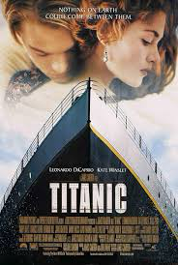
Personal Review:
"Titanic" is a beautifully made film that blends romance and history in a compelling way. The love story between Jack and Rose feels genuine and emotional, drawing viewers in despite the tragic outcome. The special effects and detailed recreation of the ship make it visually impressive. Although the film is quite long, the pacing and emotional impact keep it engaging. The ending is heart-wrenching, leaving a lasting impression. Overall, it’s a classic that successfully combines romance, drama, and spectacle.

Slide 10
Summary Of The Dark Knight:
"The Dark Knight" is a superhero film that follows Batman as he faces off against his greatest enemy, the Joker, who unleashes chaos in Gotham City. The Joker’s goal is to prove that everyone can be corrupted, and he challenges Batman’s moral code by targeting the people he cares about. Harvey Dent, the city’s promising District Attorney, becomes a tragic victim of the Joker’s schemes, transforming into the vengeful Two-Face. In a thrilling and intense battle, Batman must confront the Joker's plans while making difficult choices to protect Gotham, ultimately sacrificing his own image for the greater good.

Slide 11
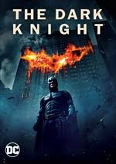
Personal Review:
"The Dark Knight" is an exceptional superhero movie that goes beyond typical action films. The story is gripping, with intense performances, especially by Heath Ledger as the Joker, who delivers a chilling, unforgettable portrayal. The film explores deeper themes like chaos, morality, and sacrifice, making it thought-provoking and more than just a comic book adaptation. The action sequences are thrilling, and the direction by Christopher Nolan keeps you on edge throughout. It's a smart, dark, and impactful film that sets a high standard for the genre, often considered one of the best superhero movies ever made.

Slide 12
Summary Of Jurassic World:
"Jurassic World" takes place 22 years after the events of "Jurassic Park." The dinosaur theme park is now open and fully functioning, attracting thousands of visitors. To boost attendance, scientists create a new, genetically engineered dinosaur called the Indominus Rex, which turns out to be highly intelligent and extremely dangerous. When the Indominus escapes, chaos erupts on the island, and park visitors are put in danger. The film follows the park’s manager, Claire, and a dinosaur trainer, Owen, as they try to stop the rampaging creature and save everyone from disaster. It’s an action-packed adventure with thrilling dinosaur encounters.

Slide 13

Personal Review:
"Jurassic World" is a fun, action-packed movie that delivers on the excitement of seeing dinosaurs brought back to life. The visuals and special effects are impressive, making the dinosaur scenes thrilling and intense. However, the story feels predictable at times, relying on a familiar formula from the original "Jurassic Park." The new genetically engineered dinosaur, Indominus Rex, adds an interesting twist, but some of the human characters lack depth. Overall, it’s an entertaining film for fans of the franchise and those who love blockbuster action, but it doesn’t quite capture the magic of the original.

Slide 14
Summary Of Inception:
"Inception" is a sci-fi thriller about Dom Cobb, a skilled thief who enters people's dreams to steal secrets from their subconscious. He is given a chance to have his criminal record wiped clean if he successfully performs "inception" — planting an idea in someone’s mind without them realising it. Cobb assembles a team to infiltrate the dreams of a businessman’s son, but as they dive deeper into multiple dream levels, the lines between dream and reality blur. The film explores themes of memory, guilt, and the power of the mind, with complex storytelling and mind-bending visuals.

Slide 15
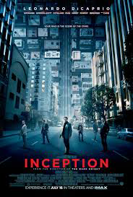
Personal Review:
"Inception" is a clever and mind-bending film that keeps you on the edge of your seat. The concept of entering and manipulating dreams is fascinating, and the story is layered with twists and turns, making it a puzzle to piece together. The direction by Christopher Nolan is exceptional, and the performances, especially by Leonardo DiCaprio, add emotional depth to the complex plot. While the film can be challenging to follow at times due to its intricate narrative, it's rewarding for those who enjoy thought-provoking, visually stunning films. It's a unique experience that leaves you questioning what's real and what's not.

Slide 16
Summary Of Avatar:
"Avatar" is a sci-fi adventure set on the lush, alien planet of Pandora. The story follows Jake Sully, a paralysed former Marine who takes the place of his deceased twin brother in a project that allows humans to control Na'vi avatars to interact with the indigenous people. As Jake gets involved with the Na'vi and learns about their way of life, he begins to question the destructive plans of the human corporation exploiting the planet's resources. The movie explores themes of environmentalism, colonialism, and cultural respect, with breathtaking visuals and groundbreaking special effects. It's a visually stunning film that blends action, romance, and a call for ecological awareness.

Slide 17
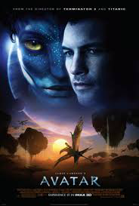
Personal Review:
"Avatar" is visually stunning, with groundbreaking special effects and an immersive world that makes Pandora feel alive. The lush landscapes and vibrant colours create a captivating experience. The story, though not entirely original, explores themes of environmentalism and the clash between nature and industrial progress. The film’s characters are a bit one-dimensional, but the emotional connection with the Na’vi and their world is powerful. While the plot is familiar, the movie's visuals and action scenes make it an exciting and thought-provoking adventure. It’s a cinematic experience that leaves a lasting impression.

Slide 18
Summary Of Avengers, Endgame:
"Avengers: Endgame" is the epic conclusion to the Marvel Cinematic Universe's Infinity Saga. After the villain Thanos wiped out half of all life in the universe using the Infinity Stones, the surviving Avengers come together for a final battle to undo the destruction. The team travels through time to gather the stones before Thanos can use them again. Along the way, they confront personal struggles and make huge sacrifices. In the end, they manage to defeat Thanos, but at great cost. The movie ties up numerous character arcs and provides a satisfying conclusion to the stories of many beloved heroes.

Slide 19
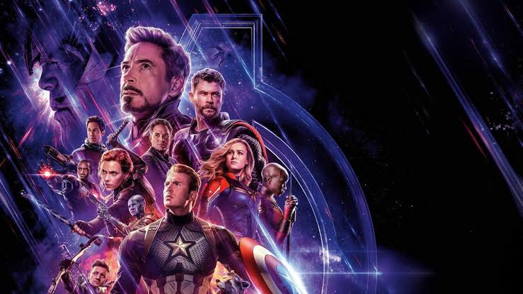
Personal Review:
"Avengers: Endgame" is an incredible and emotional conclusion to over a decade of storytelling in the Marvel Cinematic Universe. It successfully ties up numerous character arcs, with moments of humour, action, and heartbreak. The stakes feel incredibly high, and the time-travel element adds excitement and nostalgia. The film’s final battle is a visual spectacle, and the sacrifices made by key characters, especially Iron Man, give the movie emotional weight. While it’s packed with action, the movie also takes time to give fans closure and a sense of resolution. It’s a satisfying end to an era, with a mix of action, emotion, and fan service that makes it a fitting farewell for many beloved characters.

Slide 20
Summary Of Matrix:
"The Matrix" is a sci-fi action film set in a dystopian future where most humans unknowingly live in a simulated reality, created by intelligent machines to control them. The main character, Neo, learns the truth about the Matrix and joins a group of rebels led by Morpheus to fight the machines and free humanity. As Neo discovers his abilities within the Matrix, he becomes the key figure in the battle against the machines. The film explores themes of reality, control, and human consciousness, and is known for its groundbreaking special effects, including the iconic "bullet time" scenes.

Slide 21
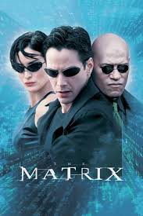
Personal Review:
"The Matrix" is a groundbreaking film that combines action, philosophy, and mind-bending concepts. The idea of a simulated reality controlled by machines is both intriguing and thought-provoking. The movie's special effects, like the iconic "bullet time," were revolutionary for its time and still stand out today. Keanu Reeves as Neo delivers a memorable performance, and the story keeps you questioning the nature of reality. It’s a classic that mixes action-packed sequences with deep, philosophical themes, making it both entertaining and intellectually stimulating. It's one of those films that remains influential and relevant in pop culture.

Slide 22
Summary Of Parasite:
"Parasite" is a dark comedy thriller that explores the class divide in South Korea. It follows the Kim family, who are struggling financially, and their attempt to infiltrate the wealthy Park family's household by securing jobs as tutors and housekeepers. As the Kim family gets deeper into the Park family's lives, secrets are uncovered, leading to unexpected and shocking consequences. The film explores themes of social inequality, greed, and deception, all while blending humor with tension and suspense. It won several awards, including the Academy Award for Best Picture, praised for its storytelling, direction, and social commentary.

Slide 23
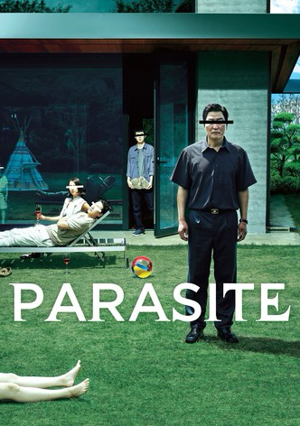
Personal Review:
"Parasite" is a brilliant and unique film that masterfully blends humour, suspense, and social commentary. The story is cleverly crafted, offering a sharp critique of class inequality, while keeping you hooked with unexpected twists. The characters are complex and relatable, and the film’s direction by Bong Joon-ho is flawless. The way the movie builds tension and drama is remarkable, and it keeps you on the edge of your seat until the very end. It’s thought-provoking, yet highly entertaining, making it deserving of all its praise and awards. A standout film that tackles deep issues with a perfect balance of wit and seriousness.

Slide 24
THANK-YOU………..

